Slide 1

NeuroDOT 2.2.0 U87
Quick Start Guide

Slide 2
Quick Start Guide
Hello! Welcome to NeuroDOT 2.2.0 Base Edition.
NeuroDOT is optimized for use in MATLAB 2015b on Windows and Unix. If you do not have MATLAB, contact your IT department or go to www.mathworks.com for more information on MATLAB. Your results may vary with other versions or operating systems.

Slide 3
Installation
To install the toolbox, open MATLAB, and copy this code to the command line, replacing the orange text with the directory you extracted the toolbox to: installpath = '[directory you extracted to]'; addpath(genpath(installpath))
This will add the toolbox to your MATLAB search path.

Slide 4
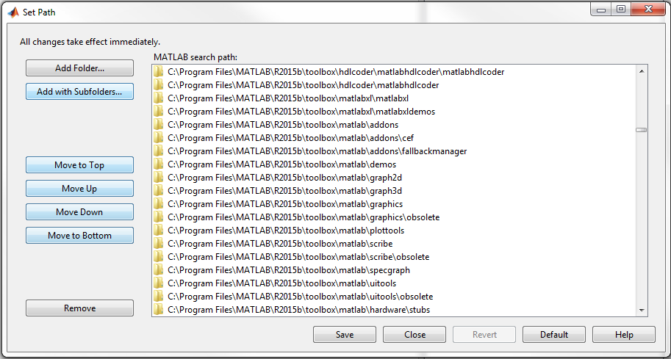
Installation
Alternatively, you can go to the MATLAB console, "Home" tab, under "Environment", and click on the "Set Path" button. Then, click on the "Add with Subfolders…" button and use the file window to navigate to the directory you extracted the toolbox to.

Slide 5
Overview of Documentation
Besides this presentation, there are 4 types of documentation included in the toolbox.
Manuals and Tutorials
Appendices
Sample Results
Help Files

Slide 6
Manuals and Tutorials
Manuals and Tutorials - These will introduce you to the basics of the toolbox and core concepts in DOT imaging.
NeuroDOT 2.2.0 Base User Manual
Introduces the user to the toolbox and contains an exhaustive, centralized reference to all components.
NeuroDOT 2.2.0 Base Tutorial - Overview
Details all components of the toolbox and explains their relationships within the experimental paradigm.
NeuroDOT 2.2.0 Base Tutorial - DOT Processing Pipeline
Takes the user step-by-step through the entire DOT processing pipeline.

Slide 7
Appendices
Appendices - These explore specific topics and features of the toolbox in deeper detail.
NeuroDOT 2.2.0 Base Appendix - Atlases
Introduces the user to atlases and other spatial concepts important to DOT.
NeuroDOT 2.2.0 Base Appendix - File IO
Reviews the file compatilibity and saving/loading capabilities of the toolbox.
NeuroDOT 2.2.0 Base Appendix - Pipeline Diagrams
Provides comprehensive diagrams of all pipelines and functionalities contained in the toolbox.
NeuroDOT 2.2.0 Base Appendix - Preprocessing Pipeline Analysis
Gives an analysis of how the preprocessing pipeline works.

Slide 8
Sample Results Appendices
Sample Results Appendices - These provide visualizations for new users who have completed the Preprocessing Pipeline tutorial to be able to compare their own results on the other samples provided with the toolbox.
NeuroDOT 2.2.0 Base Appendix - AC Sample Results
NeuroDOT 2.2.0 Base Appendix - GV Sample Results
NeuroDOT 2.2.0 Base Appendix - HW Sample 2 Results
NeuroDOT 2.2.0 Base Appendix - HW Sample Noisy Results
NeuroDOT 2.2.0 Base Appendix - RW Sample Results

Slide 9
Help Files
Help Files - These provide function-specific information similar to and viewable through MATLAB's own help documentation.
Function Help Sections
These are contained in each function, and can be called from the command line with help function_name.
Toolbox Help (through MATLAB Help Viewer)
This is a plug-in to the MATLAB Help Viewer that becomes accessible as soon as the NeuroDOT 2 directory is added to the MATLAB search path.
User Manual Index
A hyperlinked index of all components of the toolbox.
Pipeline Scripts
Pre-assembled scripts for each pipeline.

Slide 10
That’s It (For Now)
For further questions or more information, please consult the NeuroDOT U87 Base User Manual and the complete list of documentation made available in this guide.
NeuroDOT U87 Support:
Adam Eggebrecht (aeggebre@wustl.edu)

